Slide 1
A fully transparent deep signal operator network for intelligent fault diagnosis & Transparent Operator Network
Author: Qi Li, Hua Li, Wenyang Hu, Shilin Sun, Zhaoye Qin*, Fulei Chu
Speaker：Qi Li
3/27/2024
Email: liq22@tsinghua.org.cn

Slide 2
Content
Introduction
Related works
Method: TON
Experiment
Conclusion

Slide 3
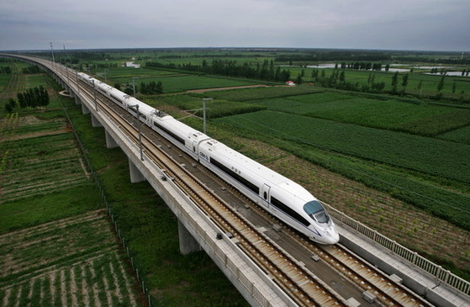
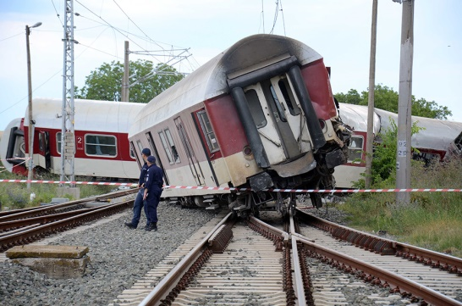
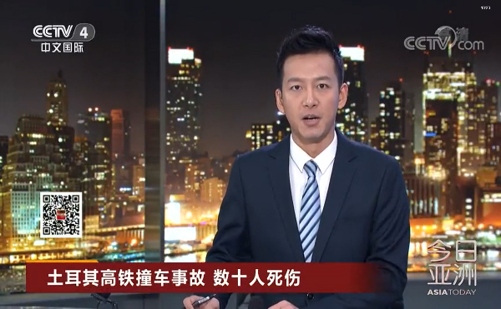
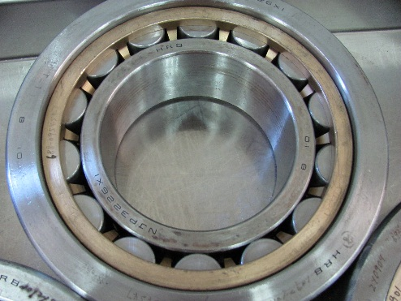
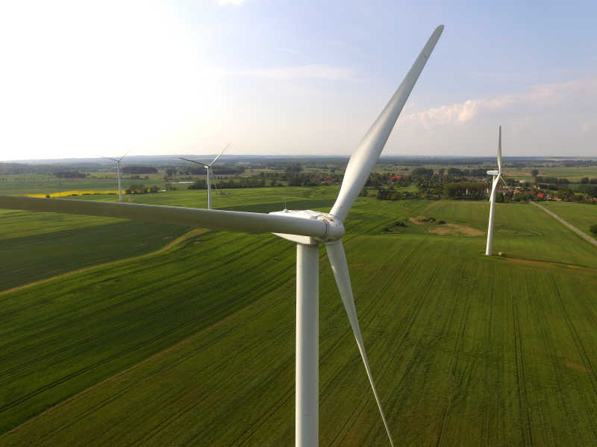
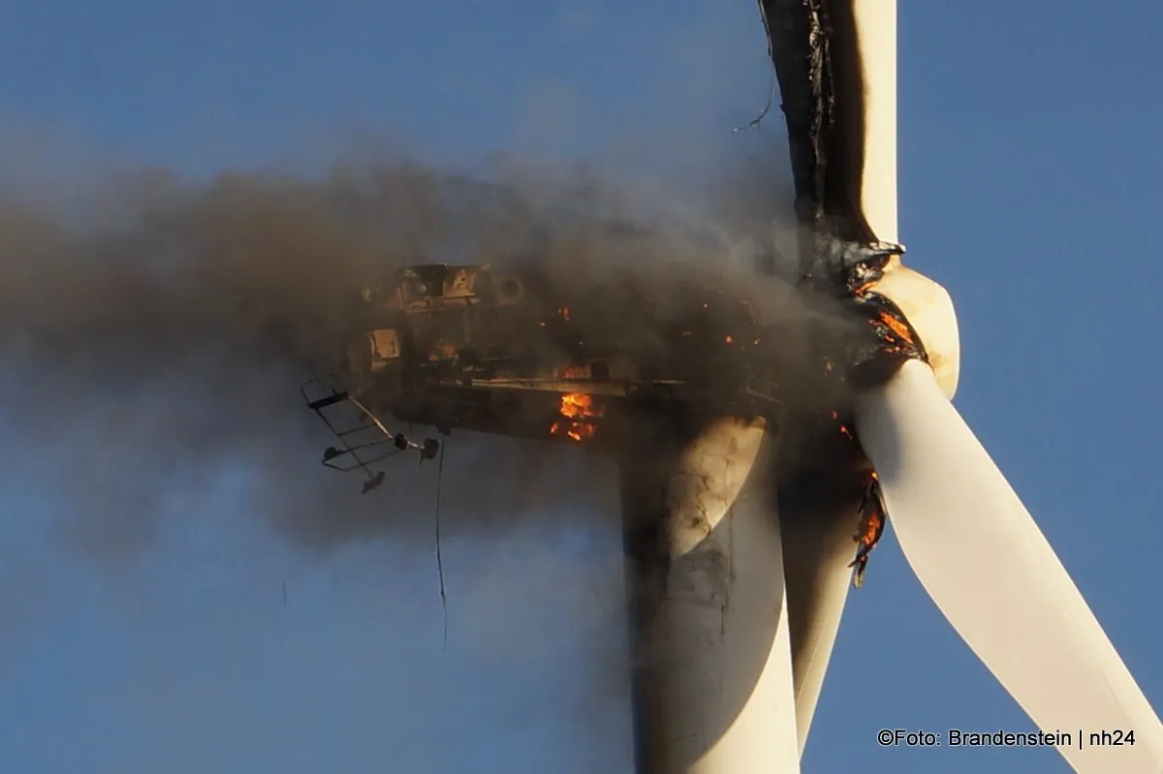
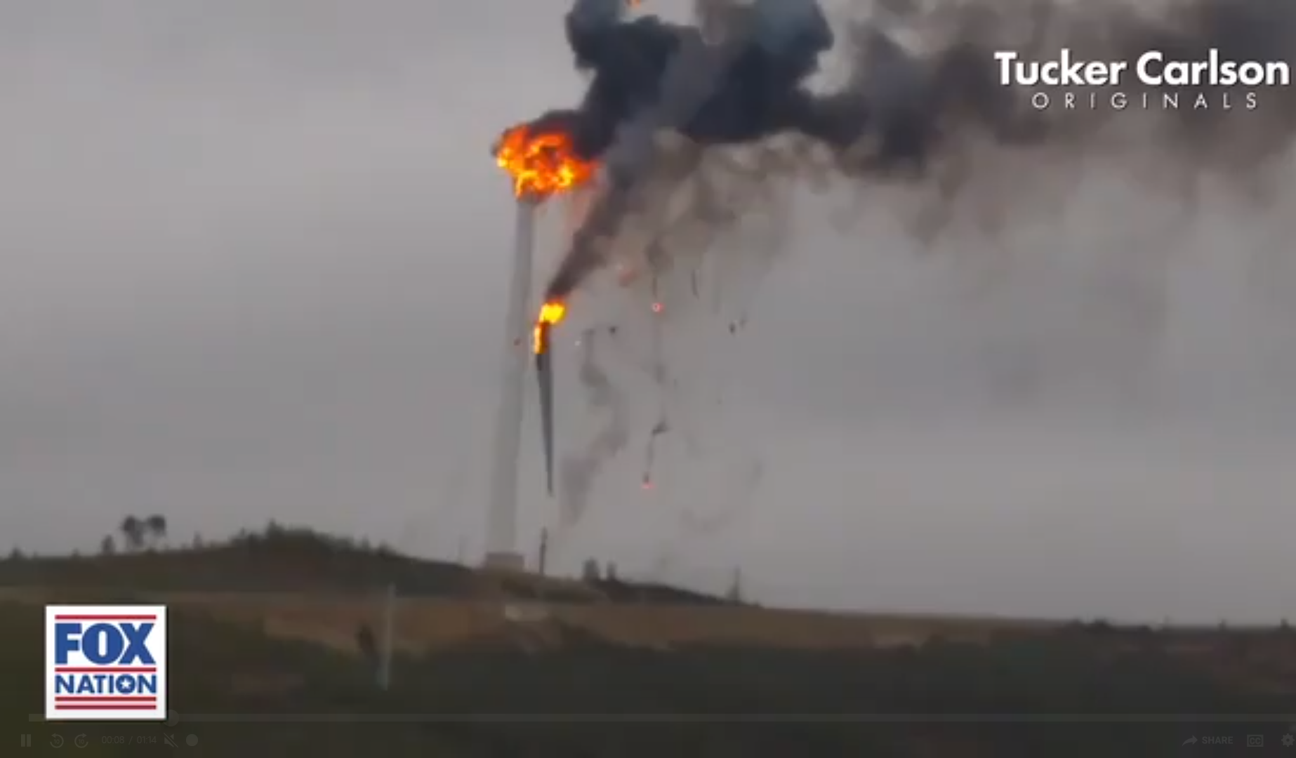
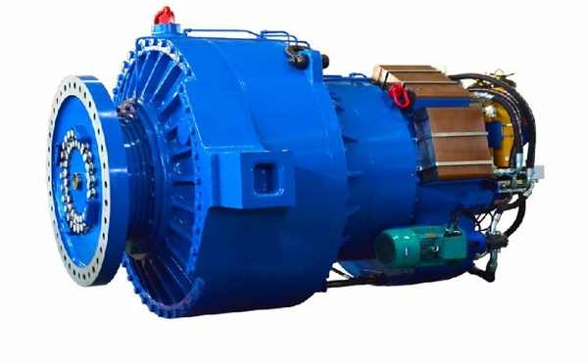
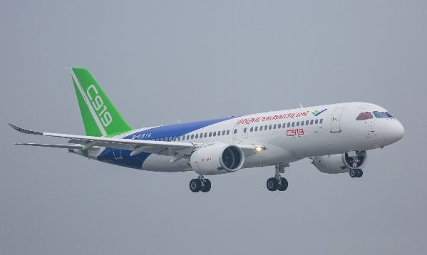
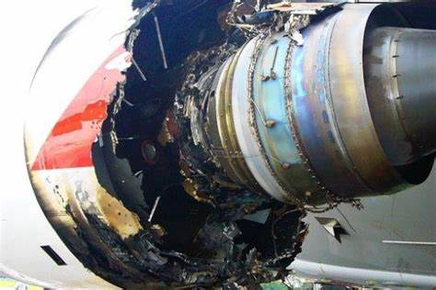
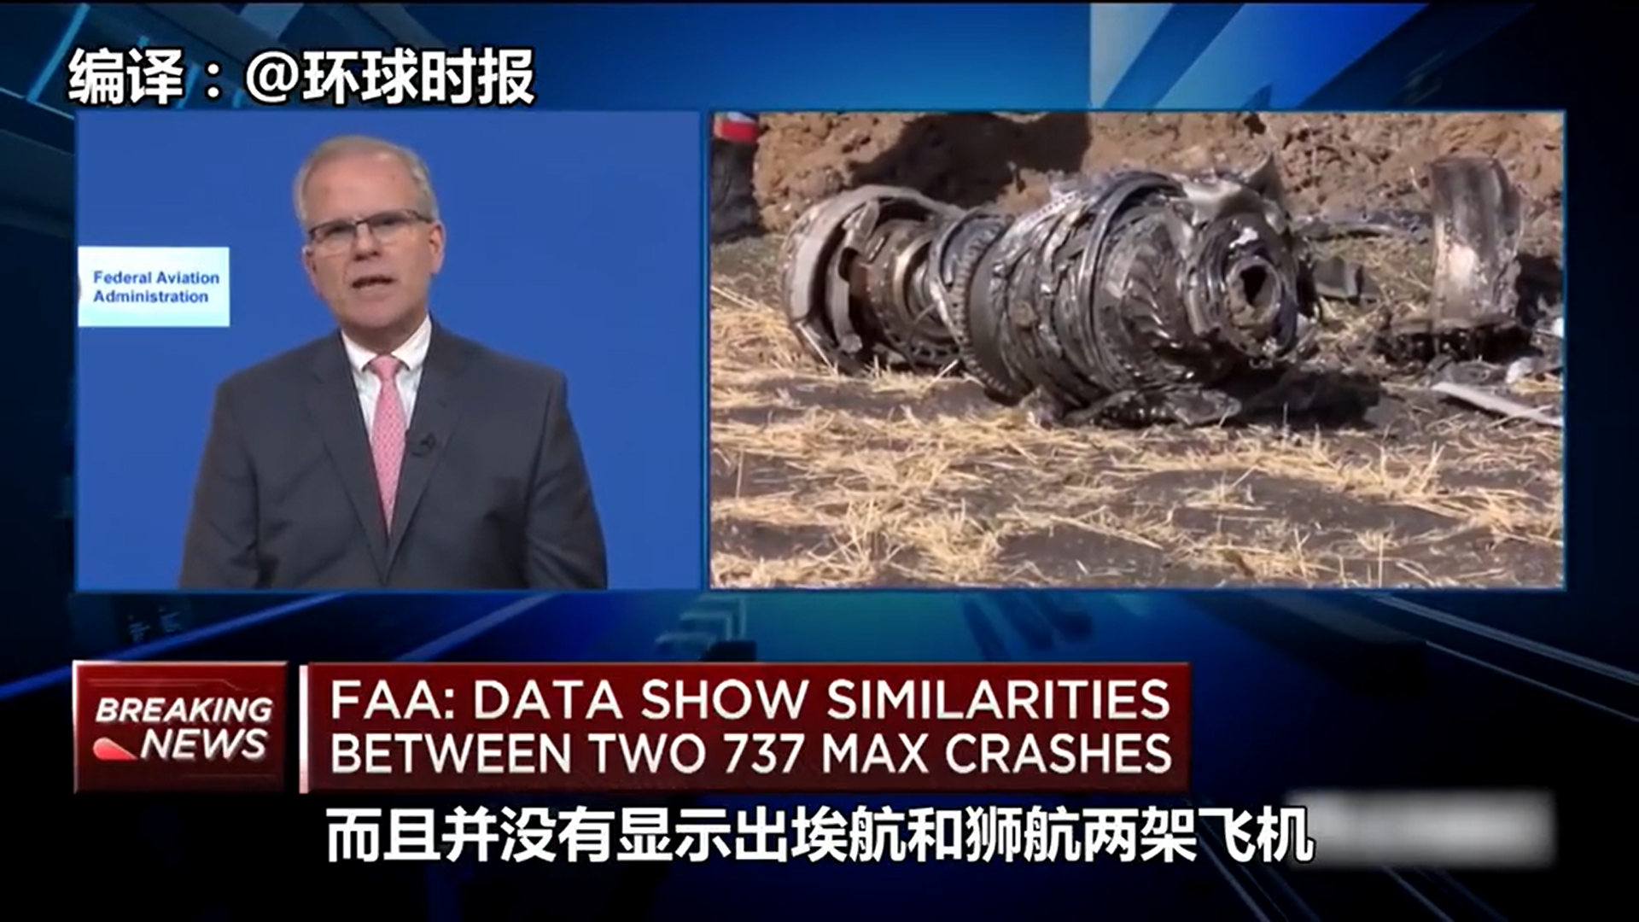
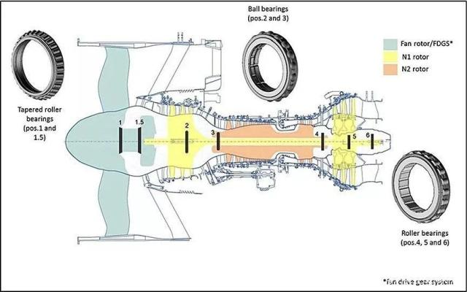

PHM
Machine
Accident
Social impact
Health management
PHM-HangZhou 2023
Notes:
PHM重要性

Slide 4
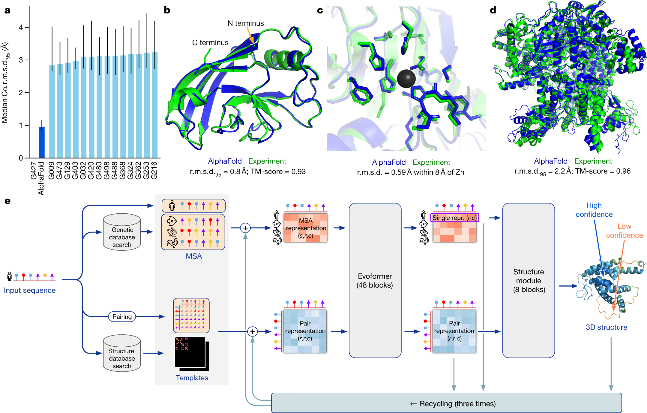
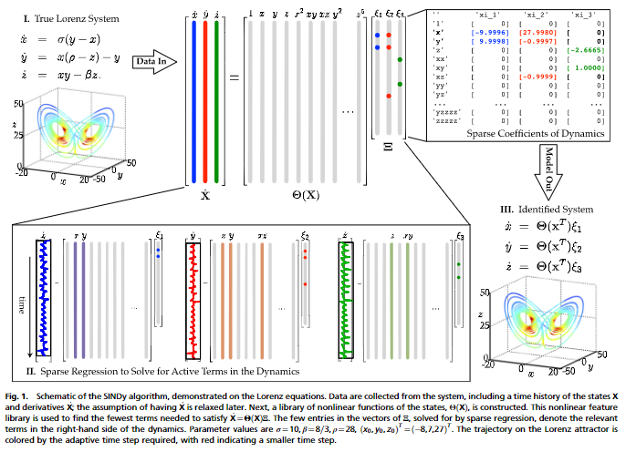
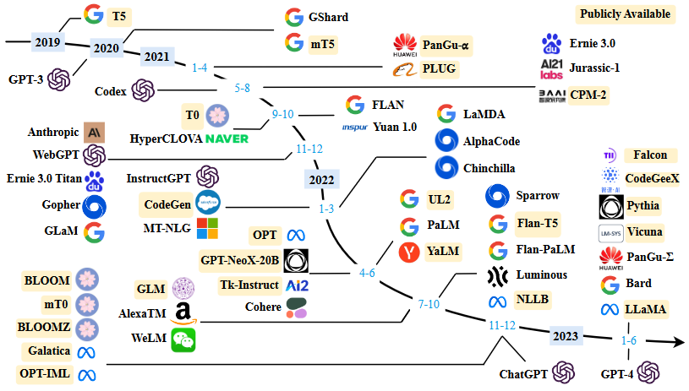
Artificial intelligence —— not for the model itself
Alphafold
Learning govern equation
Large language model
Think about what can we learn from AI
K. Tunyasuvunakool et al., “Highly accurate protein structure prediction for the human proteome,” Nature, 2021.
“Discovering governing equations from data by sparse identification of nonlinear dynamical systems.”PNAS,2015
Notes:
从AI中学习

Slide 5
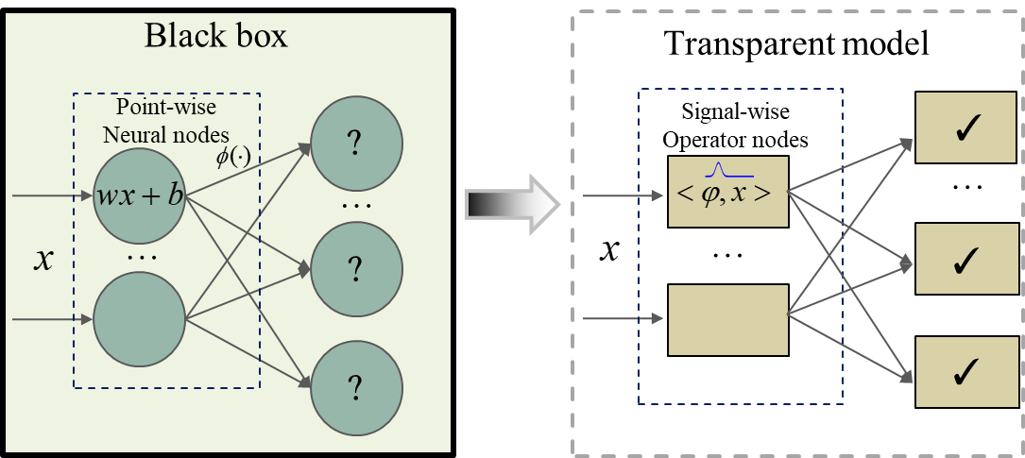
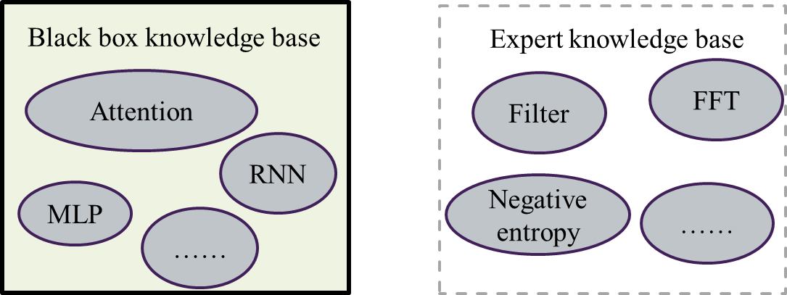
We need know how to make decision: generate transparent expert systems through AI
Signal Operator nodes
Q1 :How to design the transparent model
Knowledge-base
Q2: How to connect the Signal Operator nodes
J. J. Sun et al., “Neurosymbolic Programming for Science,” NeurIPS 2022 AI for Science Workshop. (Caltech,MIT)
Notes:
如何构建透明的深度模型，从黑箱的神经网络和白箱的专家系统收到启发： 0、从数据中学习知识的自学习能力； 1、需要构建可解释的节点； 2、需要把可解释的节点按照一定规律组织起来。

Slide 6
Content
Introduction
Related works
Method: TON
Experiment
Conclusion

Slide 7
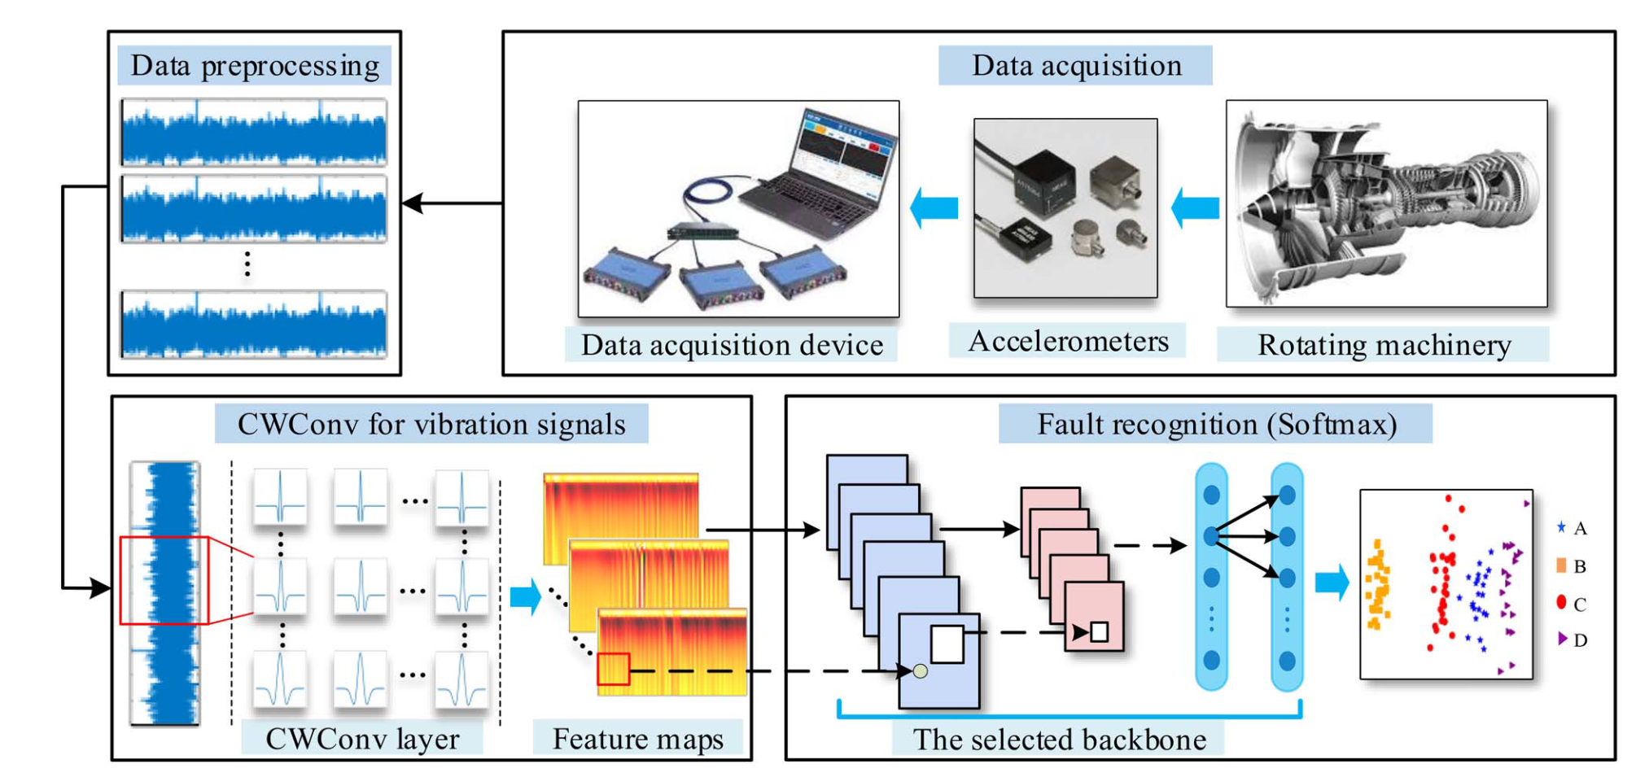
Partial knowledge
Continue wavelet transform+ CNN
Li T, Zhao Z, Sun C, 等. WaveletKernelNet: An Interpretable Deep Neural Network for Industrial Intelligent Diagnosis[J]. IEEE Transactions on Systems, Man, and Cybernetics: Systems, 2020, 52(4): 2302–2312.
Notes:
将第一层替换为 连续小波变换的结构，可以明白说通过优化，神经网络关注的频段。

Slide 8
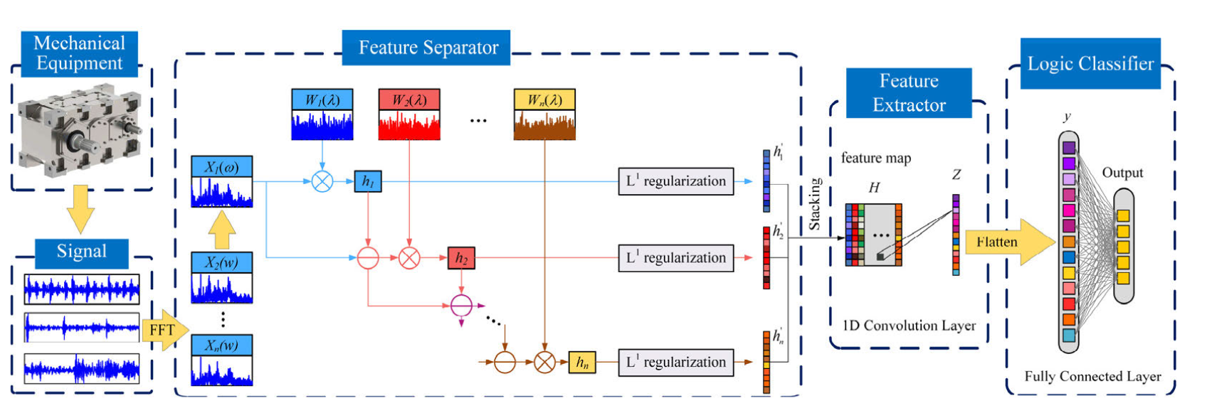
Partial knowledge
Sparse Filtering + CNN
Wu Q, Ding X, Zhao L, et al. An Interpretable Multiplication-Convolution Sparse Network for Equipment Intelligent Diagnosis in Antialiasing and Regularization Constraint[J]. IEEE Transactions on Instrumentation and Measurement.
Notes:
相似的工作，稀疏滤波的方法，让神经网络去抉择感兴趣的信号

Slide 9
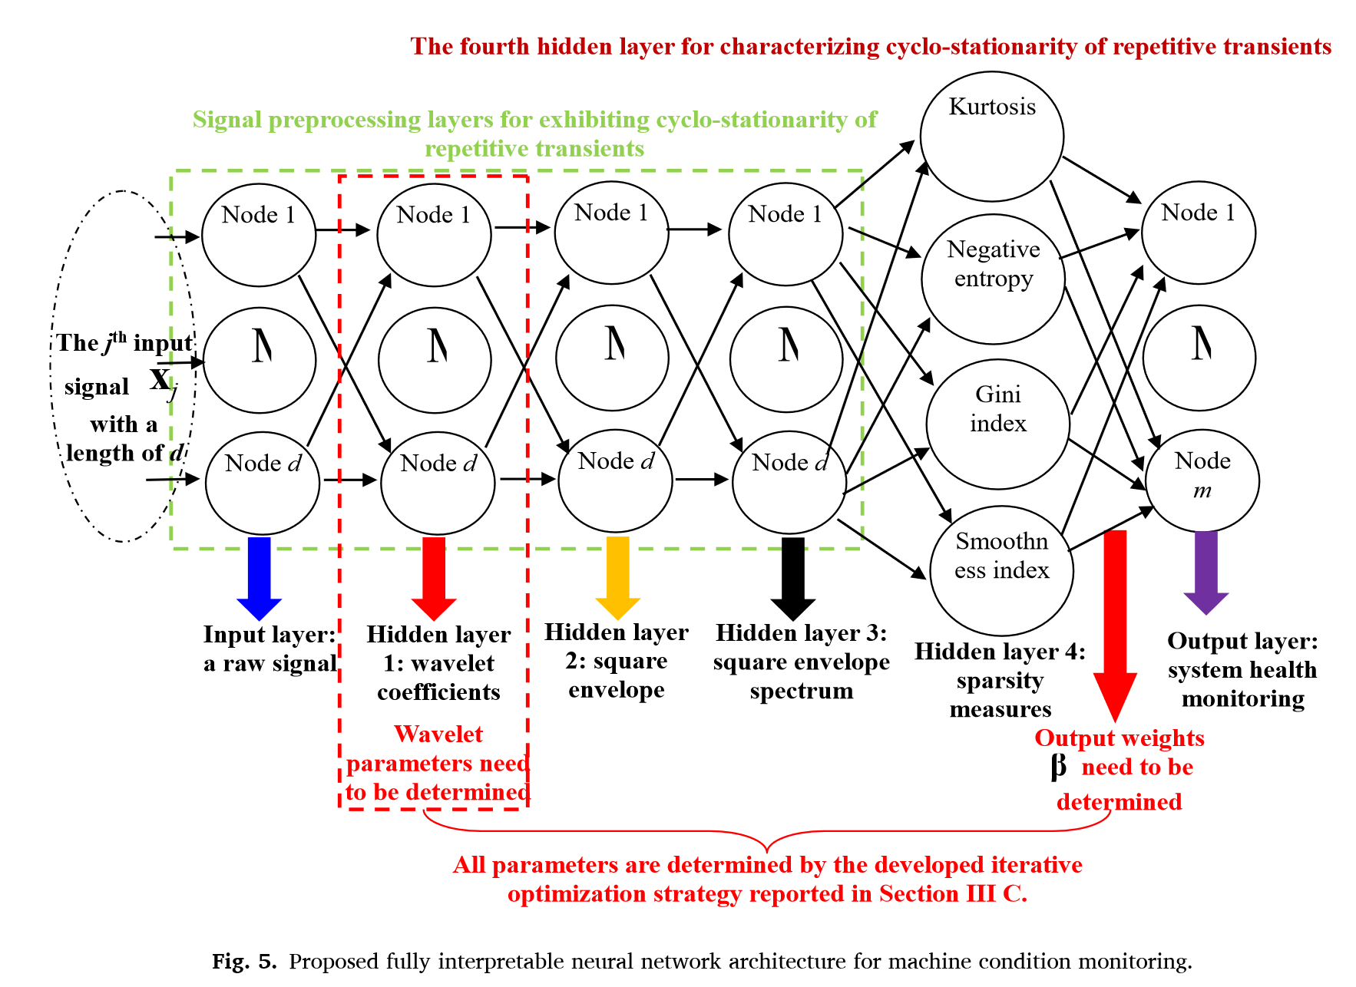
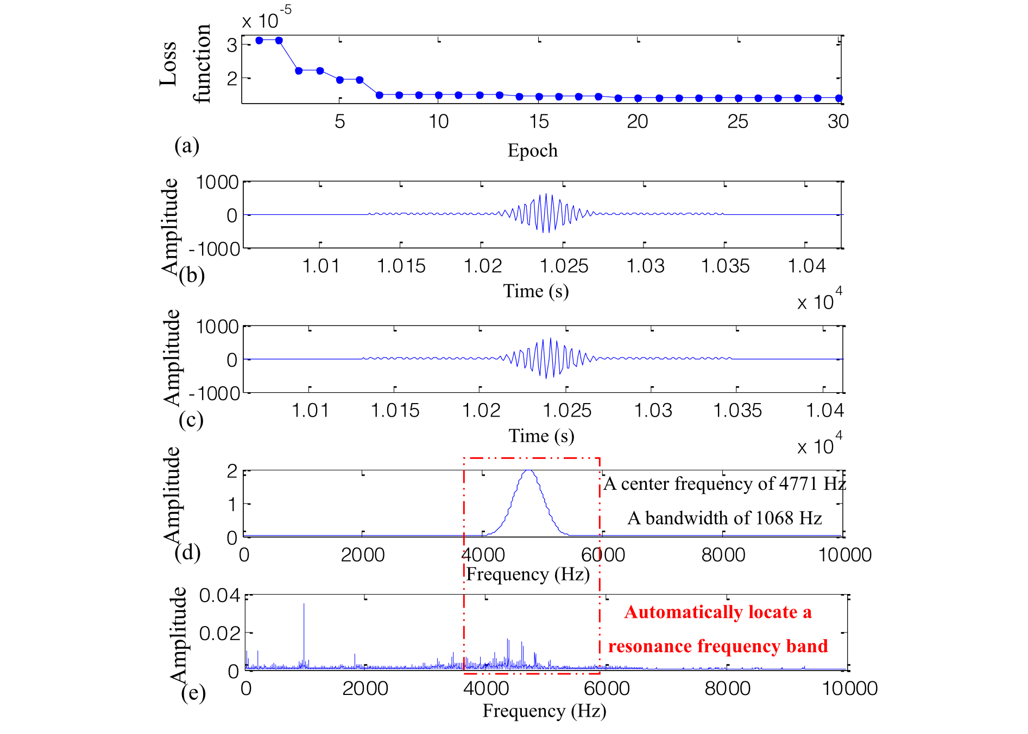
Incorporate knowledge to the model
Wavelet transform -> square envelop -> FFT -> sparsity measure -> ELM
[1] Wang D, Chen Y, Shen C, et al. Fully interpretable neural network for locating resonance frequency bands for machine condition monitoring[J]. Mechanical Systems and Signal Processing, 2022, 168: 108673.
Notes:
我们将每一个节点都赋予专家知识。 更进一步，需要规模化的自学习能力。

Slide 10
Content
Introduction
Related works
Method: TON
Experiment
Conclusion

Slide 11


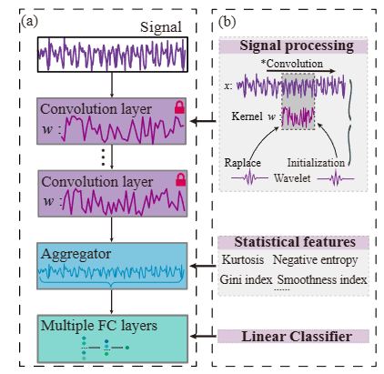
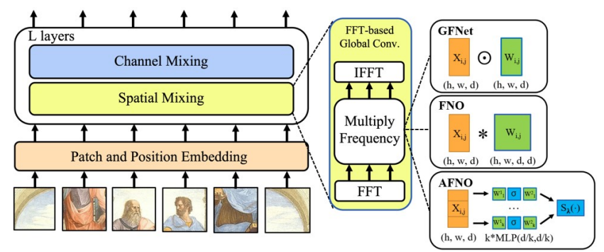
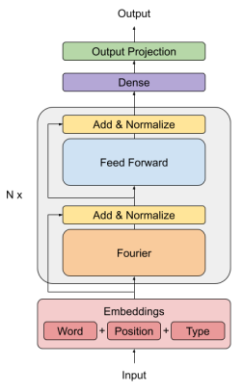

Transparent operator network（最小实现）
传统智能诊断方法
FFT嵌入
学习频域表征
仍然存在
过参数问题
J. Lee-Thorp et al, “FNet: Mixing Tokens with Fourier Transforms.” arXiv, May 2022
J. Guibas et al, “Adaptive Fourier Neural Operators: Efficient Token Mixers For Transformers,” in ICLR, 2022.
Notes:
上述的传统方法从信号处理出发，赋予神经网络以内在可解释的成分。 但是仍存在大量黑箱过程，为了实现完全可解释的模型。我们考虑从根本上改变神经网络节点构建方式。 1、参考深度网络中FFT嵌入的频域表征学习方法，结合领域内热门的算子学习。 2、降低全连接神经网络的参数量 3、从底层构建智能诊断网络。

Slide 12
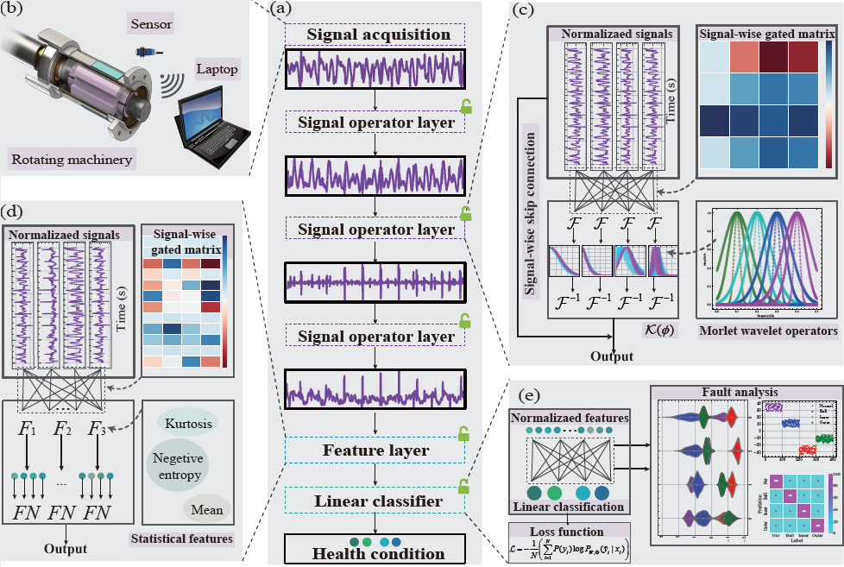
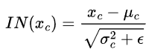
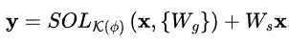
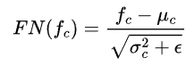
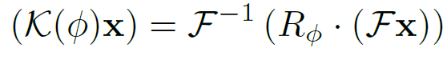
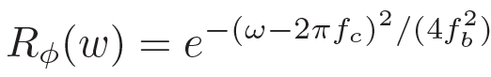
信号标准化模块
信号跨层连接
特征标准化模块
可解释傅里叶小波算子
Notes:
如图所示，在传感器获得监测信号后，TON框架采用三种类型的模块来促进透明的IFD模型。 第一个模块是在SOL中利用参数化和固有可解释的MWFO，这使得自适应滤波的透明化成为可能。 通过使用SOL，物理信息的特征层能够通过结合先前的统计特征提取更有效的健康指标。 最后，线性分类器被用作特征权重层，将提取的特征映射到故障类别。

Slide 13
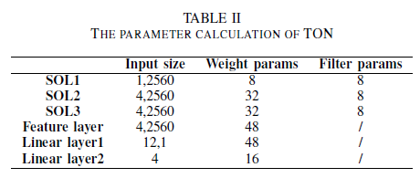
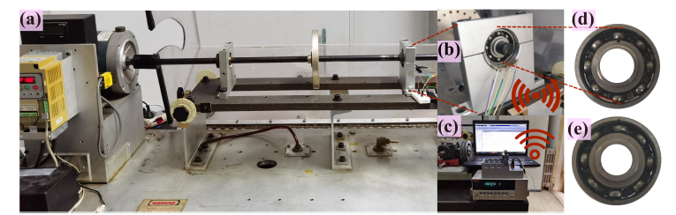
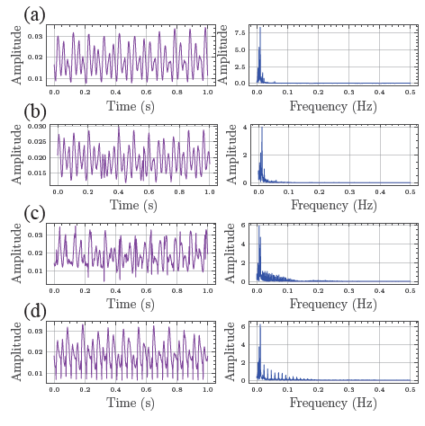
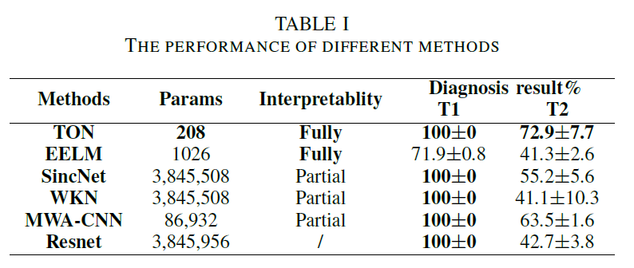
数据集采集
参数计算
四分类任务
基本诊断结果
TII 2024
Notes:
诊断结果中TON 是 参数最小的完全可解释模型 T1 代表基础的诊断能力 T2 代表基础模型的泛化性

Slide 14
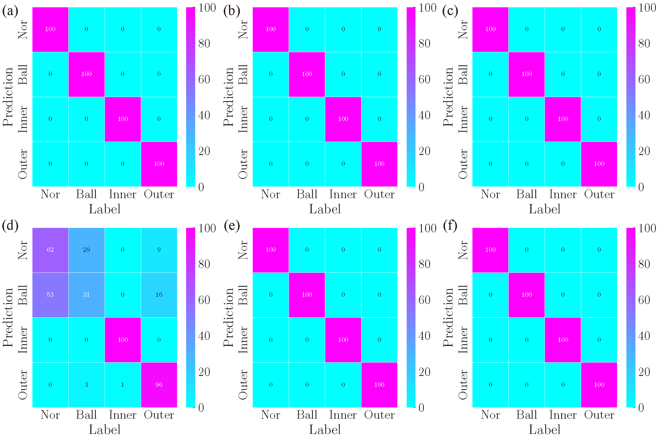
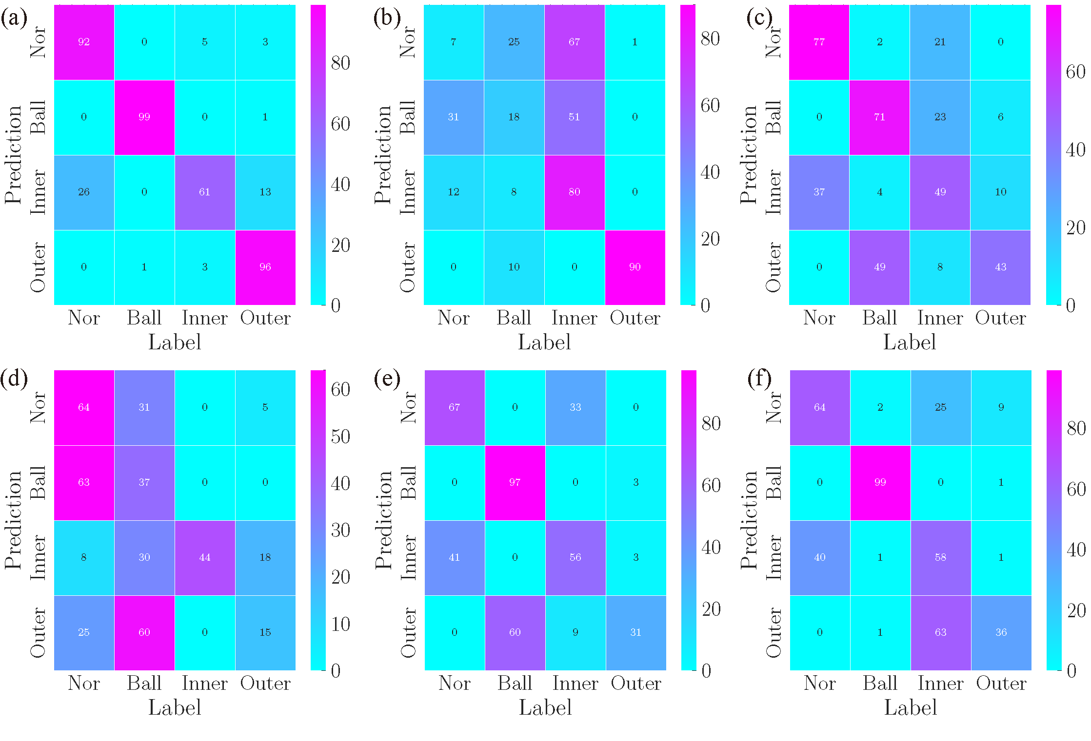
T1任务不同模型的混淆矩阵
T2任务不同模型的混淆矩阵
TII 2024
Notes:
考察T1 和T2 任务的混淆矩阵。

Slide 15
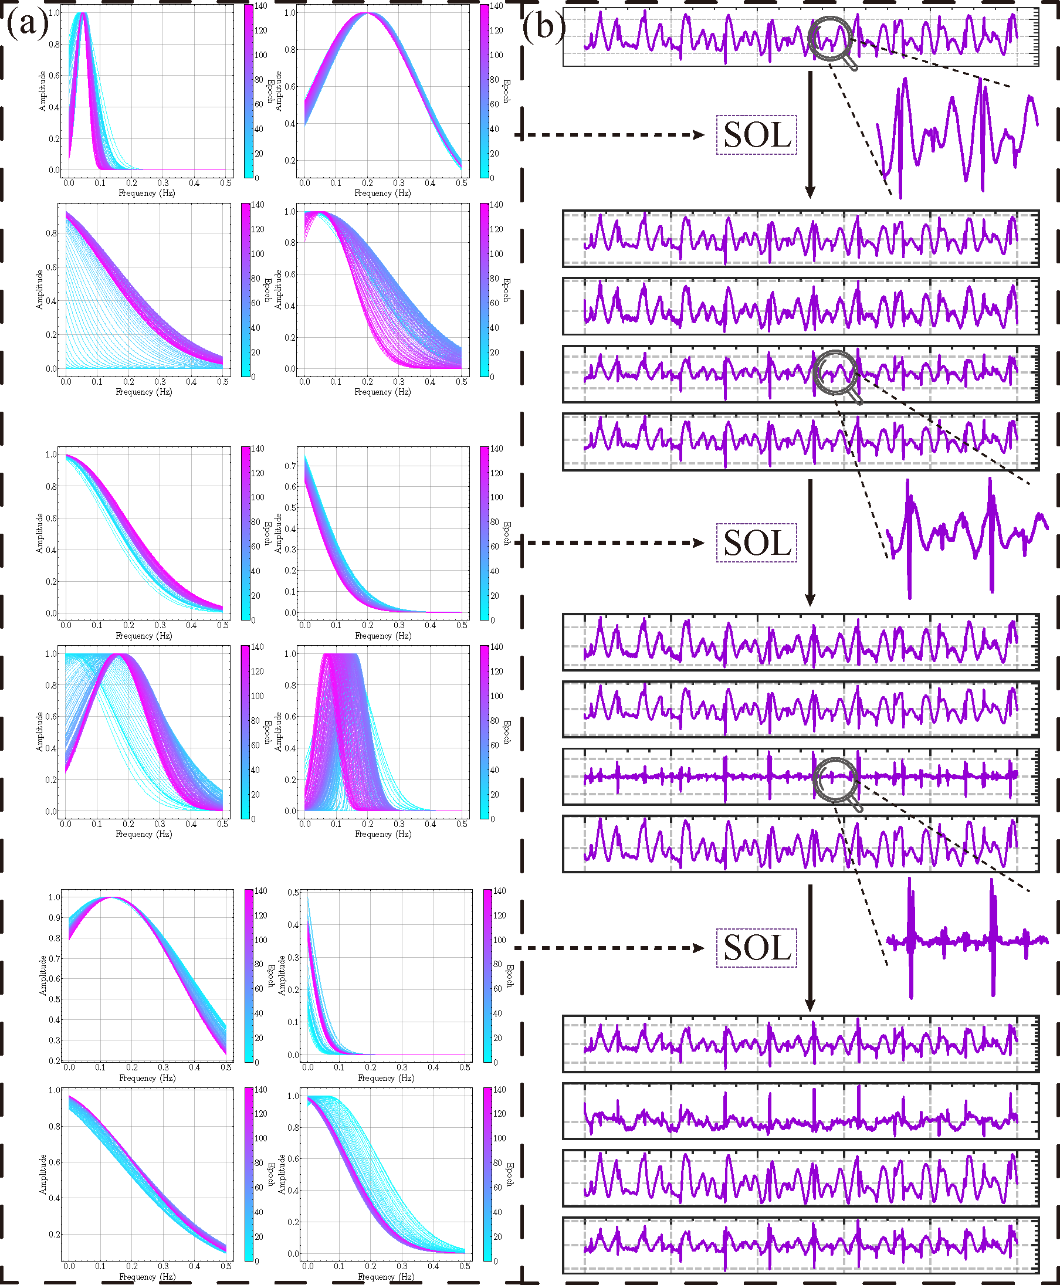
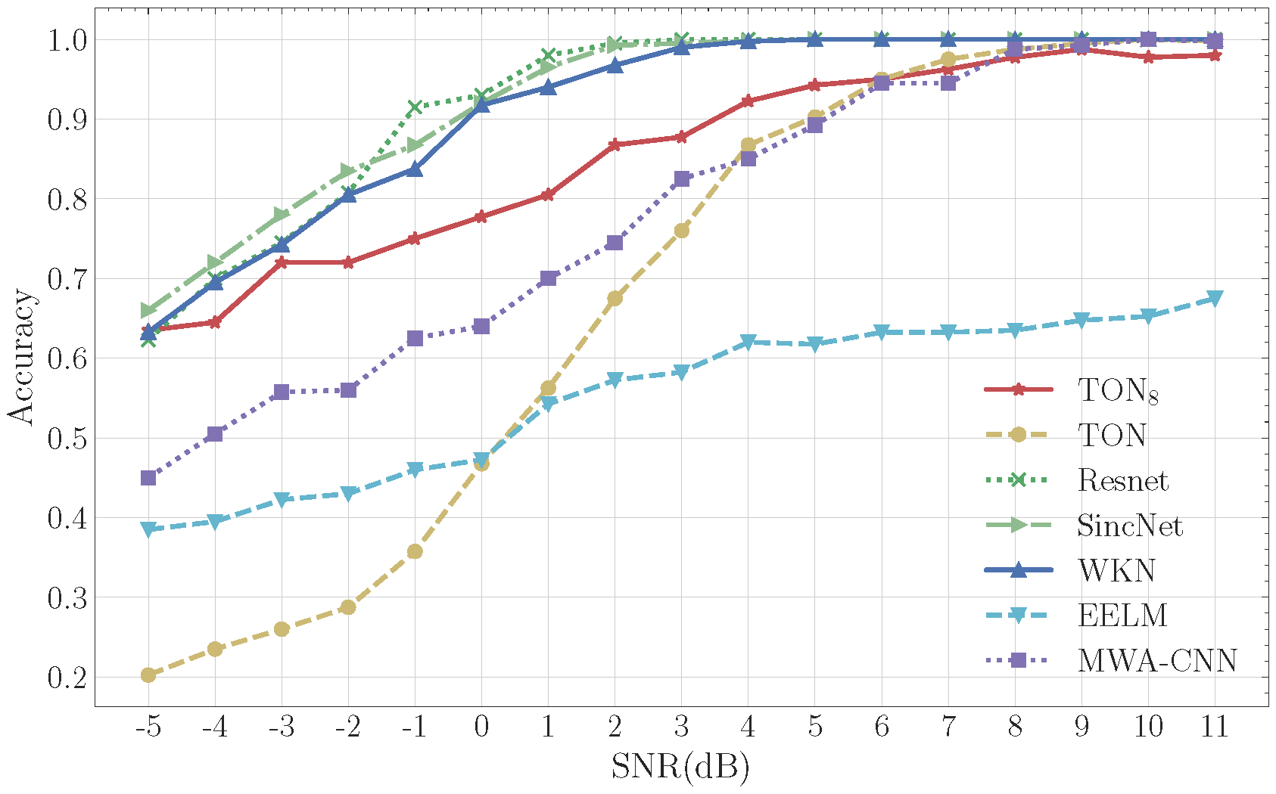
T3 鲁棒性
故障冲击成分增强
TII 2024

Slide 16
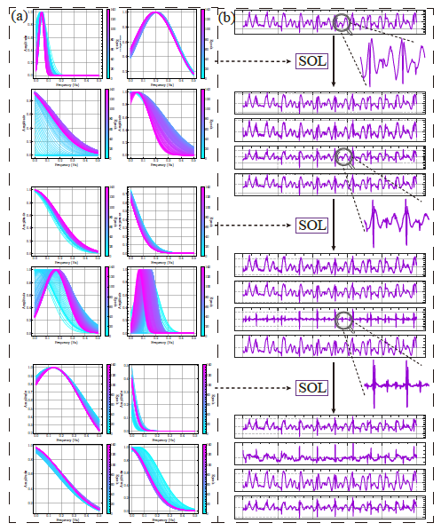
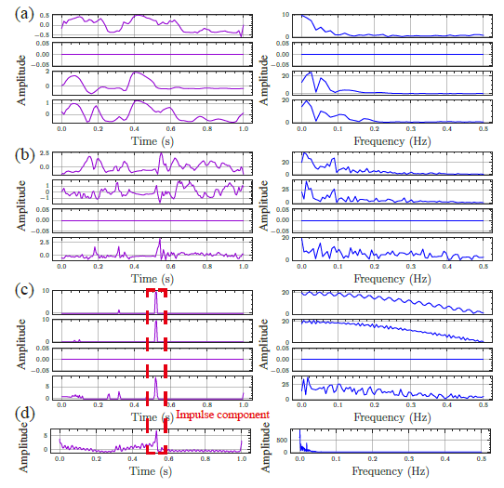
對比方法故障冲击成分丢失
Resnet 学到难以理解的知识
TII 2024

Slide 17
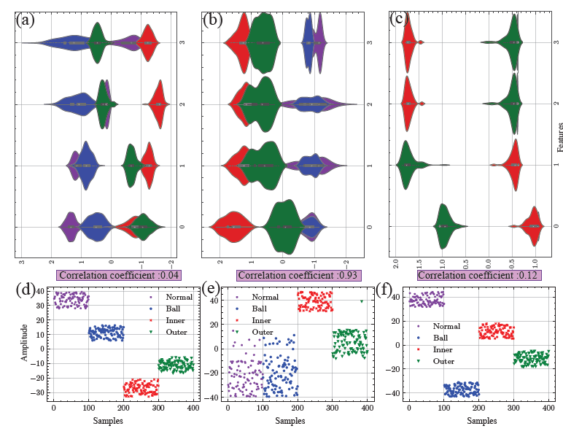
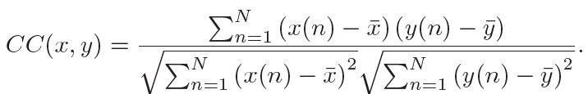
统计特征分布
计算相关系数考察特征区分度
T-SNE降维
TON :0.04
EELM： 0.93
WKN：0.12
TII 2024

Slide 18
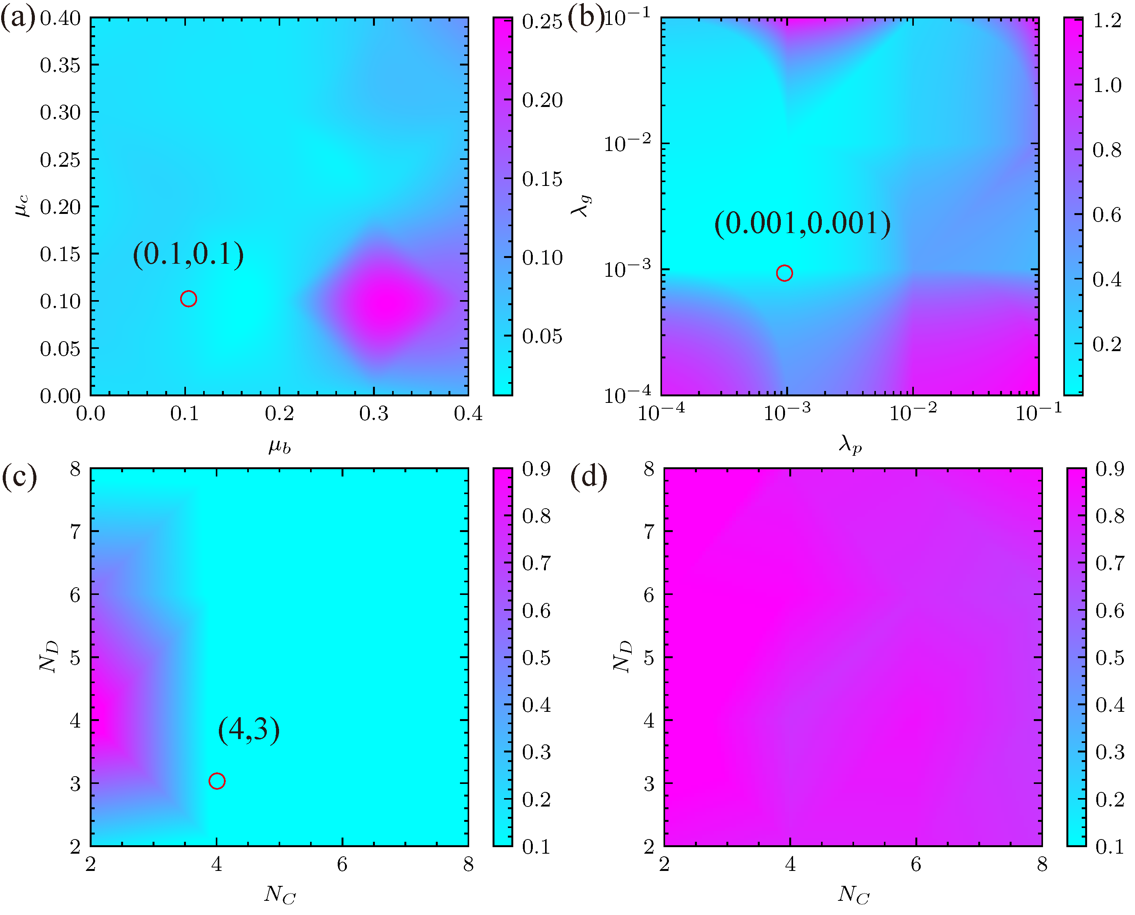
消融实验
(a) initialization distribution of center frequency and bandwidth,
(b) learning rate between gated weight and inner parameters,
(c) model depth and channel with skip connection,
(d) model depth and channel without skip connection.
TII 2024
Notes:
（a）中心频率和带宽的初始化分布， （b）门控权重与内部参数之间的学习率， （c）采用跨层连接的模型深度和通道数， （d） 无跨层连接的模型深度和通道。

Slide 19
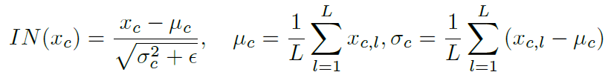
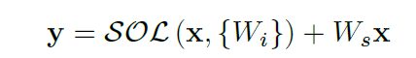
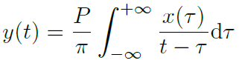
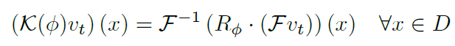
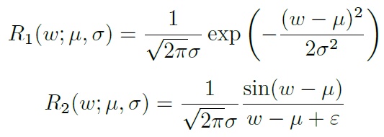
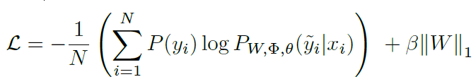
1. Signal normalization
2. Signal-wise gated matrix
3.1. Hilbert transform
3.2. Neural Fourier operator
3.3. Frequency filtering
4. Stack the basic layer
5. Train!
PHM-HangZhou 2023
Notes:
以下是会议的版本，除了TII中的傅里叶算子，还引入了sinc算子和希尔伯特变换。结果展示会比TII论文糙一点

Slide 20
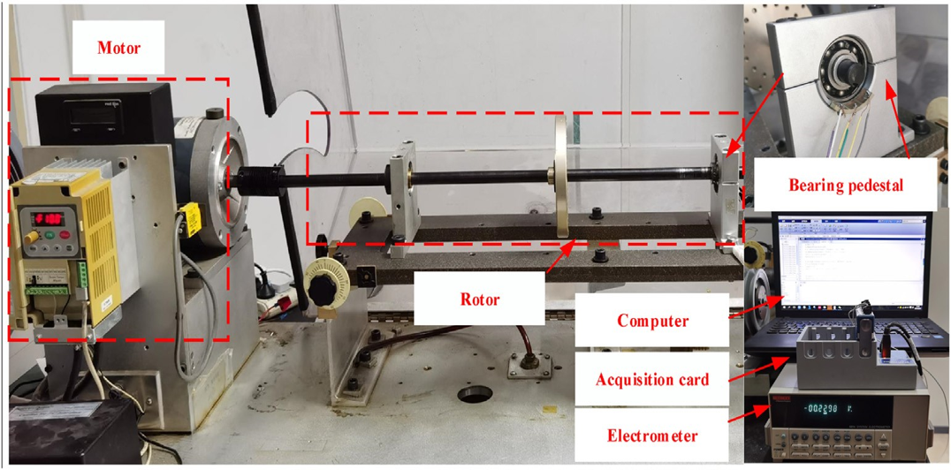
Experiment setting
Zhang L, Zhang F, Qin Z, et al. Piezoelectric energy harvester for rolling bearings with capability of self-powered condition monitoring[J]. Energy, 2022, 238: 121770.
Notes:
obtained
using a piezoelectric energy harvester. In Fig. 3, the test
rig uses an arc-shaped piezoelectric sheet placed between the
outer race of a rolling bearing and the bearing pedestal. When
subjected to compressive load from the rotation motion the
piezoelectric sheet generates electricity. The voltage signals
from the energy harvester contain rich frequency information
which can be used as a sensor to detect rolling bearing
faults. The dataset contains voltage signals from four health
conditions: normal (Nor), inner race fault (IF), ball fault
(BF), and outer race fault (OF). The collected signals with
40960Hz sampling frequency are segmented at different times
to build 100 samples for the training set, validation set, and
test set, respectively. Each sample has 2560 data points. All
the diagnostic models are implemented in python 3.8, and
PyTorch 1.12. The model training are realized based on the
Linux-5.10.102.1 and GeForce RTX 3090 GPU.

Slide 21






Training percedure
Input signals
PHM-HangZhou 2023

Slide 22








PHM-HangZhou 2023

Slide 23





Slide 24












Kernel density estimation

Slide 25
自强不息，厚德载物
李奇
机械工程系
2024年3月27日

